Slide 1
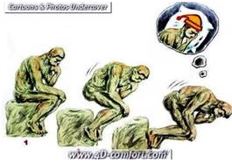
Creative Thinking
http://creativethinking.net/WP04_Exercises.htm

Slide 2
Practical Thinking
A man went outside in the pouring rain with no protection, but not a hair o his head got wet. How come?
What is directly in the middle of Australia?
A soccer player kicks a ball. It goes 10 feet and comes back to him. How is this possible?
A cowboy rode to an inn on Friday. He stayed two nights and left on Friday. How can this be?

Slide 3
The man is bald.
The letter R.
He kicked the ball upwards.
The horse was called Friday.

Slide 4
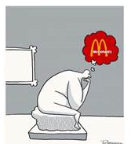

Slide 5
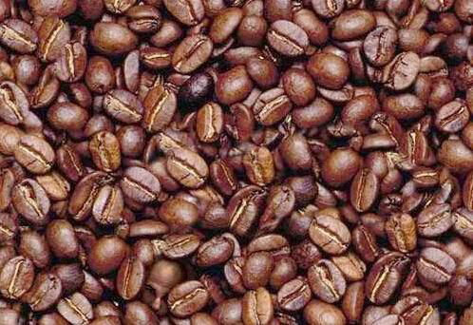
Where is the man’s head??

Slide 7
A Short Neurological Test 1- Find the C below. OOOOOOOOOOOOOOOOOOOOOOOOOOOOOOO OOOOOOOOOOOOOOOOOOOOOOOOOOOOOOO OOOOOOOOOOOOOOOOOOOOOOOOOOOOOOO OOOOOOOOOOOOOOOOOOOOOOOOOOOOOOO OOOOOOOOOOOOOOOOOOOOOOOOOOOOOOO OOOOOOOOOOOOOOOOOOOOOOOOOOOOOOO OOOOOOOOOOOOOOOOOOOCOOOOOOOOOOO OOOOOOOOOOOOOOOOOOOOOOOOOOOOOOO OOOOOOOOOOOOOOOOOOOOOOOOOOOOOOO OOOOOOOOOOOOOOOOOOOOOOOOOOOOOOO OOOOOOOOOOOOOOOOOOOOOOOOOOOOOOO

Slide 8
A Short Neurological Test 1- Find the C below. OOOOOOOOOOOOOOOOOOOOOOOOOOOOOOO OOOOOOOOOOOOOOOOOOOOOOOOOOOOOOO OOOOOOOOOOOOOOOOOOOOOOOOOOOOOOO OOOOOOOOOOOOOOOOOOOOOOOOOOOOOOO OOOOOOOOOOOOOOOOOOOOOOOOOOOOOOO OOOOOOOOOOOOOOOOOOOOOOOOOOOOOOO OOOOOOOOOOOOOOOOOOOCOOOOOOOOOOO OOOOOOOOOOOOOOOOOOOOOOOOOOOOOOO OOOOOOOOOOOOOOOOOOOOOOOOOOOOOOO OOOOOOOOOOOOOOOOOOOOOOOOOOOOOOO OOOOOOOOOOOOOOOOOOOOOOOOOOOOOOO

Slide 9
2- If you already found the C, now find the 6 below. 99999999999999999999999999999999999999999999999 99999999999999999999999999999999999999999999999 99999999999999999999999999999999999999999999999 69999999999999999999999999999999999999999999999 99999999999999999999999999999999999999999999999 99999999999999999999999999999999999999999999999

Slide 10
2- If you already found the C, now find the 6 below. 99999999999999999999999999999999999999999999999 99999999999999999999999999999999999999999999999 99999999999999999999999999999999999999999999999 69999999999999999999999999999999999999999999999 99999999999999999999999999999999999999999999999 99999999999999999999999999999999999999999999999

Slide 11
3 - Now find the N below. It's a little more difficult. MMMMMMMMMMMMMMMMMMMMMMMMMMMMNMM MMMMMMMMMMMMMMMMMMMMMMMMMMMMMMM MMMMMMMMMMMMMMMMMMMMMMMMMMMMMMM MMMMMMMMMMMMMMMMMMMMMMMMMMMMMMM MMMMMMMMMMMMMMMMMMMMMMMMMMMMMMM

Slide 12
3 - Now find the N below. It's a little more difficult. MMMMMMMMMMMMMMMMMMMMMMMMMMMMNMM MMMMMMMMMMMMMMMMMMMMMMMMMMMMMMM MMMMMMMMMMMMMMMMMMMMMMMMMMMMMMM MMMMMMMMMMMMMMMMMMMMMMMMMMMMMMM MMMMMMMMMMMMMMMMMMMMMMMMMMMMMMM

Slide 13
This is NOT a joke. If you were able to pass these 3 tests, you can cancel your annual visit to your neurologist. Your brain is great and you're far from having a close relationship with Alzheimers.

Slide 14
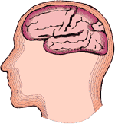
Count every "F" in the following text:
FINISHED FILES ARE THE RE SULT OF YEARS OF SCIENTI FIC STUDY COMBINED WITH THE EXPERIENCE OF YEARS..... (SEE BELOW)
HOW MANY 'F's?

Slide 15
Count every "F" in the following text:
FINISHED FILES ARE THE RE SULT OF YEARS OF SCIENTI FIC STUDY COMBINED WITH THE EXPERIENCE OF YEARS..... (SEE BELOW)
HOW MANY 'F's?
THERE ARE 6

Slide 16
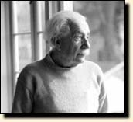
FINISHED F ILES ARE THE RESULT OF YEARS OF SCIENTIF IC STUDY COMBINED WITH THE EXPERIENCE OF YEARS.....
The brain cannot process "OF".

Slide 17
What do you see?

Slide 18
Notes:
One of the most useful of all thinking modes in creative problem solving is visual thinking. It is especially effective in solving problems where shapes, forms, or patterns are concerned. To improve your powers of visualization, concentrate on the accompanying illustration.

Slide 19
The question usually asked in connection with this design is whether you see either the vase or the two human profiles. A mentally flexible person will see both. For purposes of this mental exercise, however, try to see as many additional items in the picture as you can. Look at it from many different points of view and from as many angles as you wish. Then check the list below. Some of the items may seem far—fetched. But, remember, the idea is to use your imagination freely.
Answers: 1. An anvil. 2. An overpass pillar on a highway. 3. Champagne glass. 4. Piano stool. 5. Tower with revolving restaurant. 6. Minute-timer. 7. Propeller. 8. Chess-game rook or castle. 9. Fruit holder. 10. Bird bath. 11. Chalice. 12. Rubber grommet. 13. Keyhole slot in door. 14. An extrusion die. 15. Two Pontiac automobiles about to crash head on. 16. A screw jack. 17. An arrowhead going into an object. 18. Two girls sitting back-to-back and holding parcels on their heads.

Slide 20
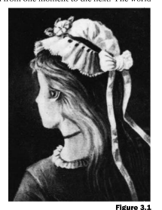

Slide 21
Read aloud the following colors as fast as you can: - See more at: http://creativethinking.net/articles/#sthash.ObUEBhAs.dpuf

Slide 22
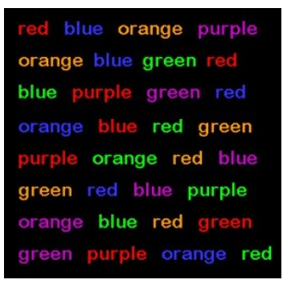
Now quickly read aloud the colors of the following words … not the words themselves, but the colors in which the words are shown: - See more at: http://creativethinking.net/articles/#sthash.ObUEBhAs.dpuf
Notes:
Difficult isn’t it? No matter how hard you concentrate, no matter how hard you focus, you will find that it is almost impossible to read the colors aloud without becoming confused. The word patterns have become so strong in your brain that they are activated automatically whether you want them to be or not. This is why if you always think the way you always thought, you’ll always get what you always got.

Slide 23
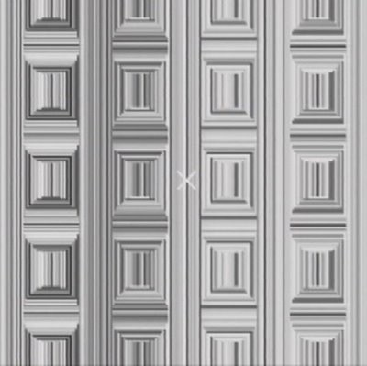
Here is a classic door with rectangular frames. If you look at the X in the middle of the door and think circles instead of rectangles, circles will pop up out of nowhere.

Slide 24
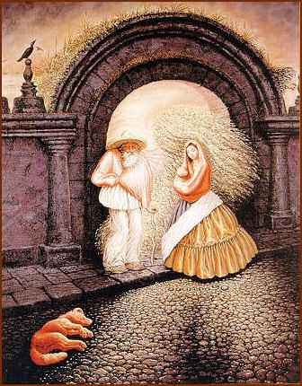
There are nine people in this picture. Inspect the picture and see how many can you find.
If you find 6, you have an ordinary power of observation.
Find 7, you have an above average power of observation.
Find 8, you are very observant. Congratulate yourself.
Find 9, you are extremely observant. You are very intuitive and creative.

Slide 27
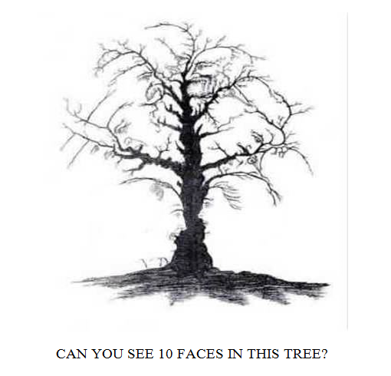

Slide 28
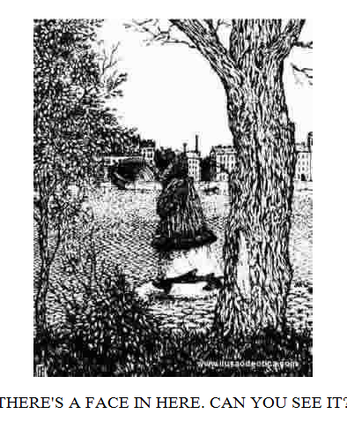

Slide 29
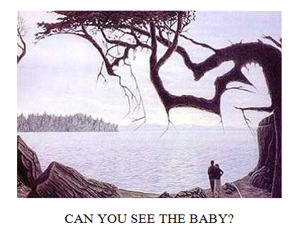

Slide 30
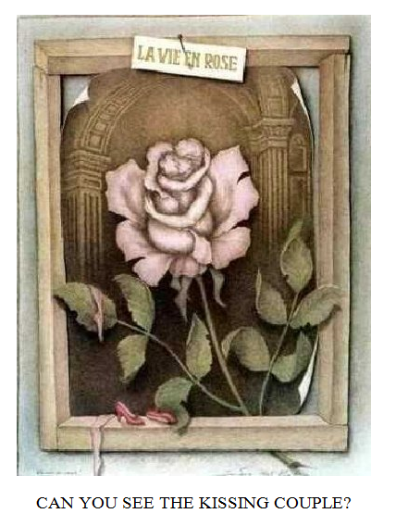

Slide 31
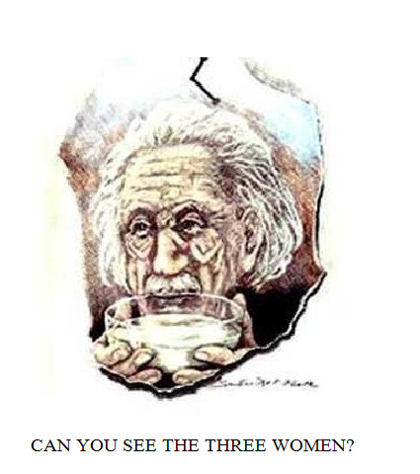

Slide 32
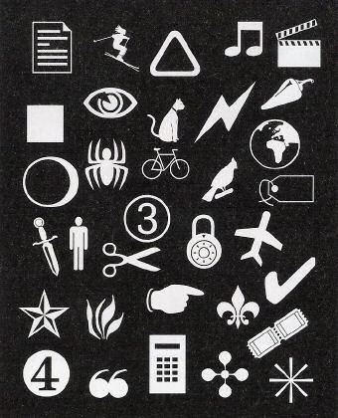
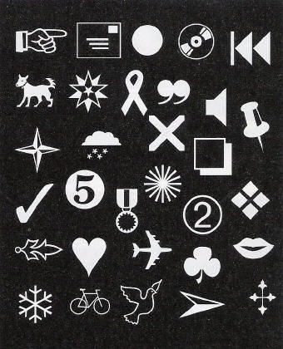
Only one of these objects appears in both drawings. Can you find it? If you can find it within one minute, consider yourself highly observant.

Slide 33
Only one of these objects appears in both drawings. Can you find it? If you can find it within one minute, consider yourself highly observant.

Slide 34
Below are four simple questions. Try to answer all of them before looking at the answers.
#1: How do you put a giraffe into a fridge?
#2: How do you put an elephant into a fridge?
#3: The King of the Jungle is holding a meeting for all of the animals. One of them is not there. Which one?
#4: You are standing on the bank of an alligator infested river and have to get to the other side. What do you do?

Slide 35
A survey by Accenture found that approximately 90% of managers are likely to incorrectly answer all of the questions. Many school children under the age of six will actually get these questions right. What does this say about management thinking? And now for the answers to the four question: #1: Open the fridge, put the giraffe inside, and then close the fridge.
#2: Open the fridge, remove the giraffe, put the elephant inside, and close the fridge.
#3: The elephant. The elephant is in the fridge.
#4: You swim across the river because all the alligators are attending the meeting.

Slide 36
This is what the questions are trying to find out: #1 checks to see if you try to make simple things complicated and make assumptions about problem boundaries. Nobody actually said that the fridge was not big enough to put a giraffe inside!
#2 tests your ability to consider previous actions. Who says that they are four separate questions?
#3 simply tests your memory.
#4 checks to see how quickly you learn. After all, you must have answered question 4 correctly if you are a successful Senior Manager.

Slide 37
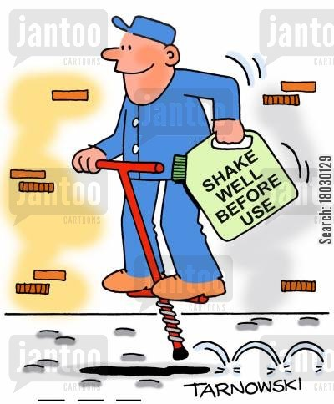

Slide 38
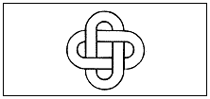
Choose a partner. Designate a timer. One of the partners draws and the other times. Exactly copy this design.

Slide 39
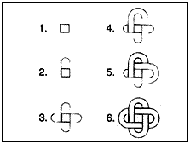
The design can be copied easily and accurately in less than 15 seconds. One step-by-step approach is as follows:
Notes:
If it took anywhere from one to three minutes, try a different approach and copy it again to see if that new point of view helps you copy the design more quickly. The design can be copied easily and accurately in less than 15 seconds. One step-by-step approach is as follows:

Slide 40
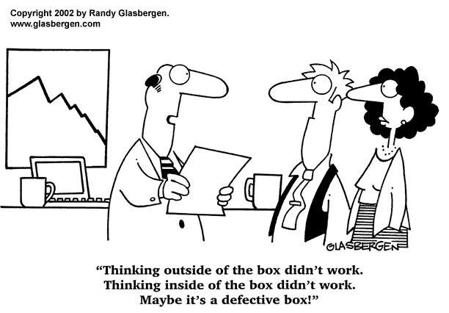

Slide 41
This activity is designed to increase your flexibility and your ability to overcome the restrictions of habit. The name of what color is concealed in each sentence?
Newspaper editors decided to go on strike. (Red)
The cab lacked proper brakes to stop at the intersection. (Black)

Slide 42
This activity is designed to increase your flexibility and your ability to overcome the restrictions of habit. The name of what color is concealed in each sentence?
Newspaper editors decided to go on strike. (Red)
The cab lacked proper brakes to stop at the intersection. (Black)

Slide 43
A big, old, hungry dog appeared at our door every morning.
The cop persuaded him not to create a disturbance. The Brazilian student Paulo lives around the corner from us. You shouldn't let an upstart like him bother you.
He let out a big yell, owing to the injuries he received when he fell. 6.La Jolla venders decided to cut their prices in half. 7. Long rayon fabrics were loaded on the truck. 8. The Austrian physicist Wolfgang Pauli lacked the requisite documents to enter the U.S.
You shouldn't sell this fossil very cheaply because it is a rare specimen.
The new law hit everybody's pocketbook pretty hard.
Notes:
In order to identify the hidden colors, you have to disregard the signs that say "stop"—such as word spacings, periods, and commas. People who are habit-ridden will find this exercise very difficult.

Slide 44
Would it be easier with the colors given?
White copper
Silver gold
Lilac
Gray
Lavender
Yellow
Tan
olive

Slide 45
A big, old, hungry dog appeared at our door every morning.
The cop persuaded him not to create a disturbance. The Brazilian student Paulo lives around the corner from us. You shouldn't let an upstart like him bother you.
He let out a big yell, owing to the injuries he received when he fell. La Jolla venders decided to cut their prices in half. Long rayon fabrics were loaded on the truck. The Austrian physicist Wolfgang Pauli lacked the requisite documents to enter the U.S.
You shouldn't sell this fossil very cheaply because it is a rare specimen.
The new law hit everybody's pocketbook pretty hard.
Notes:
In order to identify the hidden colors, you have to disregard the signs that say "stop"—such as word spacings, periods, and commas. People who are habit-ridden will find this exercise very difficult.

Slide 46
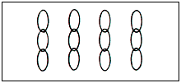
With some problems, a creative solution can only occur after the elements or parts of the problem have been reorganized into a different pattern. This requires that you juggle the parts in your mind's eye. With this in mind, see if you can solve this problem: A businessman brought back from Europe four pieces of chain in solid gold, each consisting of three links

Slide 47
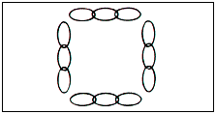
He wanted to keep them as an investment, but his wife felt that—joined together—the pieces would make a lovely necklace. She went to a jeweler and said, "I want you to connect these pieces to make a necklace. How much will it cost?" The jeweler laid the individual pieces of chain out in this pattern:

Slide 48
He told the lady, "I charge $2.50 to break a link and $2.50 to melt it together again. Since you have four corners, it will cost you $20." The lady said, "That's too much. Actually you can do it for $15." The problem, then, is to construct a necklace, breaking and joining only three links. How would you do it?

Slide 49
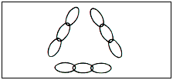
As long as you think of the segments of chain as four sides of a square or as segments of a circle, you can't solve this problem. The moment you shift your focus and regard one of those segments—not as an immutable structure—but as a stockpile of individual links, you've made the necessary breakthrough. At the woman's suggestion, the jeweler placed three segments in a triangular pattern, took apart the remaining segment, and used those three links to close the three comers of the necklace.
http://www.glencoe.com/sec/busadmin/entre/teacher/creative/stimulate/exer11.htm
Notes:
Most people will have to juggle the elements visually, drawing them in different arrangements before arriving at the triangular pattern that leads to solution. This juggling of the parts of a problem results in a reorganization. But before that can happen, you have to feel free to destroy the original pattern in which the problem was presented.

Slide 50
A man lives on the twelfth floor of an apartment building. Every morning he takes the elevator down to the lobby and leaves the building. In the evening, he gets into the elevator, and, if there is someone else in the elevator -- or if it was raining that day -- he goes back to his floor directly. Otherwise, he goes to the tenth floor and walks up two flights of stairs to his apartment.
WHY?

Slide 51
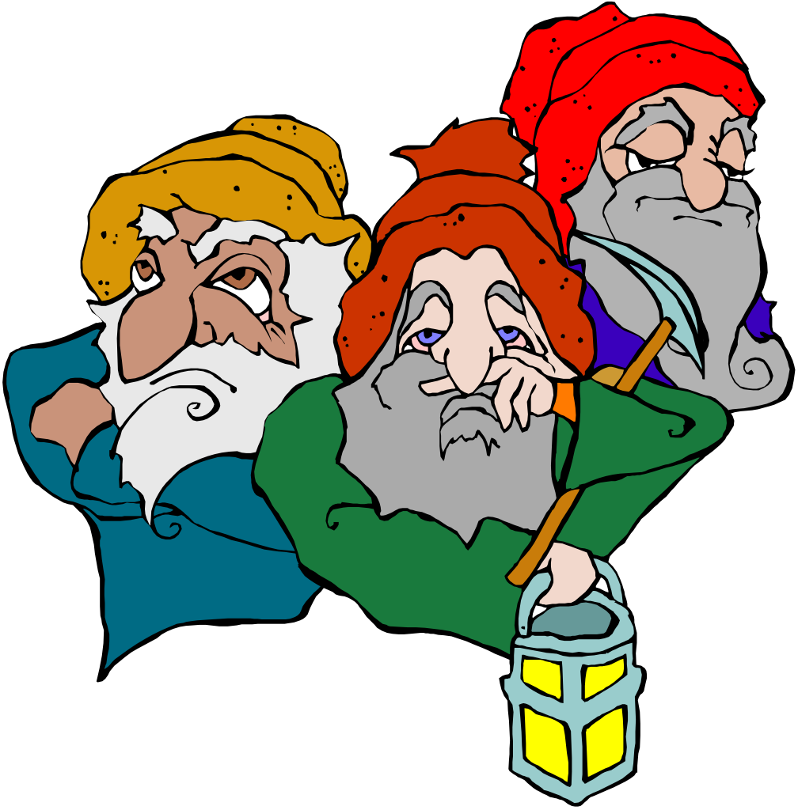
The man is a dwarf. He can't reach the upper elevator buttons, but he can ask people to push them for him. He can also push them with his umbrella.

Slide 52
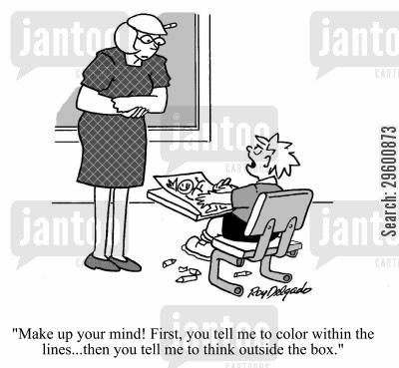

Slide 53
In the middle of the ocean is a yacht. Several corpses are floating in the water nearby
WHY?

Slide 54
Alternate Solution #1
A group of people were on an ocean voyage in a yacht. One day, they decided to go swimming -- they put on their swimsuits and dove off the side. They discovered belatedly that they have forgotten to put a ladder down the side of the yacht and were unable to climb back in, so they drowned.
Alternate Solution #2
The same situation, but they set out a ladder that was just barely long enough. When they dove into the water, the boat, without their weight, rose slightly in the water, putting the ladder just out of reach.

Slide 55
A man is lying dead in a room. There is a large pile of gold and jewels on the floor, a chandelier attached to the ceiling, and a large open window.
http://www.rinkworks.com/brainfood/

Slide 56
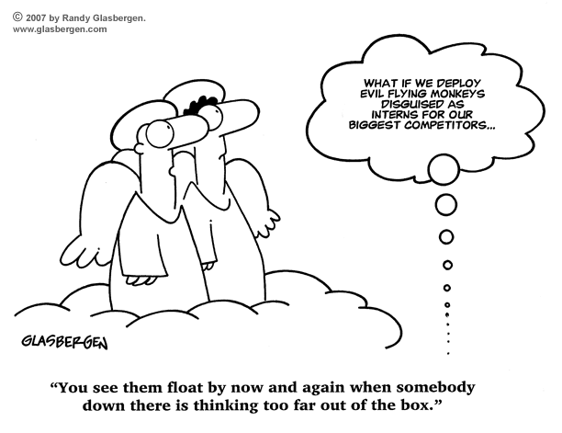

Slide 57
The room is the ballroom of an ocean liner which sank some time ago. The man ran out of air while diving in the wreck.
http://www.rinkworks.com/brainfood/s/latreal3.shtml

Slide 58
#2
 | A farmer had nine sheep, and all but seven died. How many did he have left

Slide 59
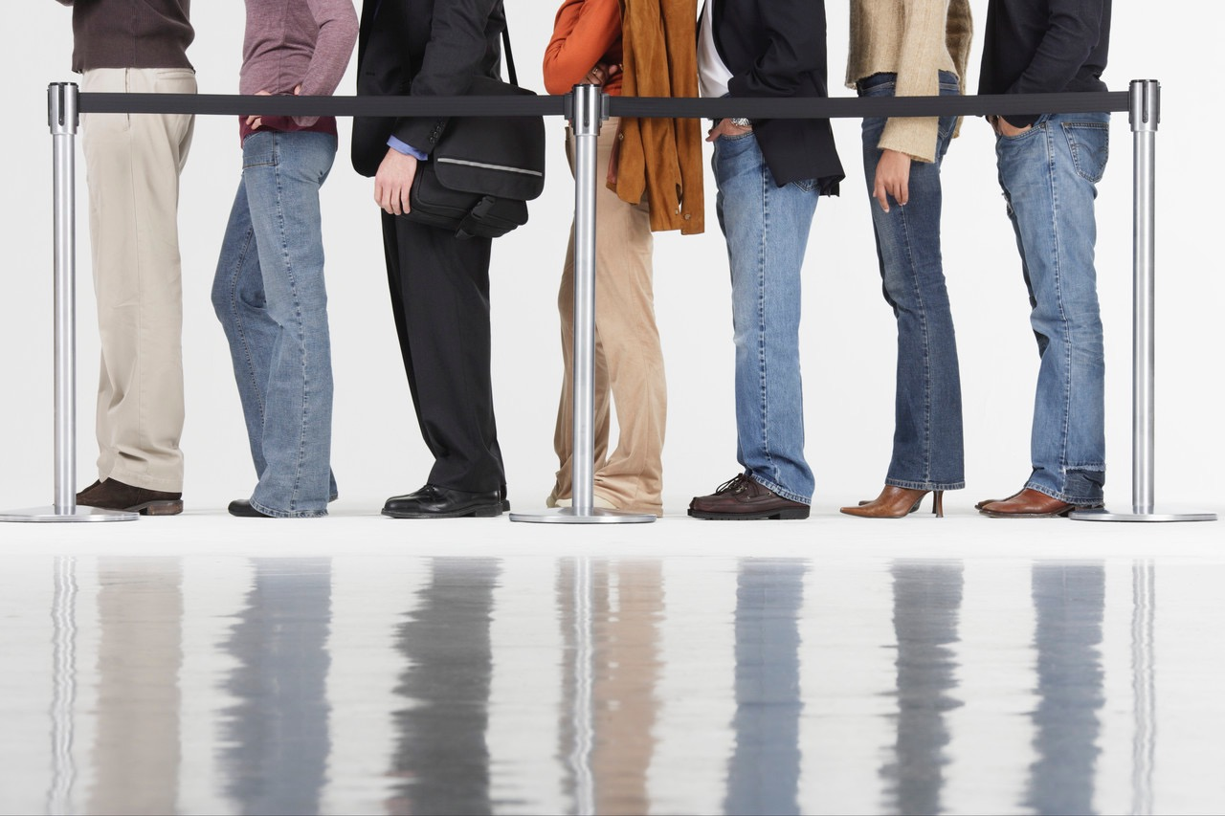
seven

Slide 60
I have two U.S. coins that add up to fifty-five cents. One is not a nickel. What coins are they?

Slide 61
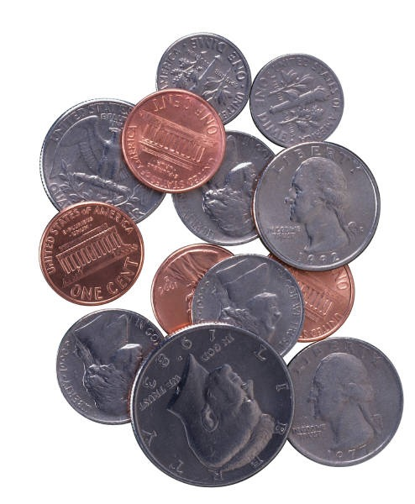
A nickel and a half dollar. Only one is not a nickel.

Slide 63
You are a bus driver. At the first stop of the day, eight people get on board. At the second stop, four get off, and eleven get on. At the third stop, two get off, and six get on. At the fourth stop, thirteen get off, and one gets on. At the fifth stop, five get off, and three get on. At the sixth stop, three get off, and two get on. What color are the bus driver's eyes?

Slide 64
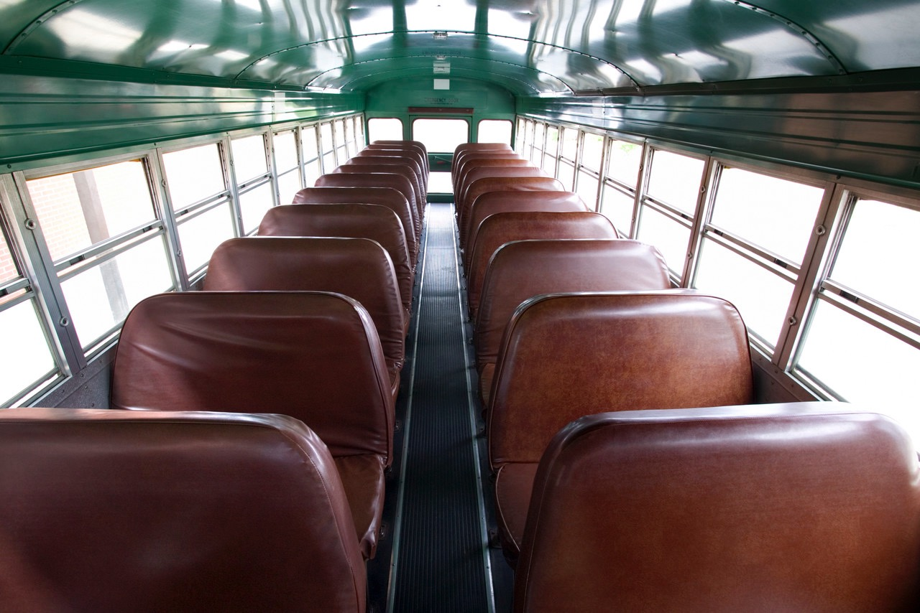
Whatever color yours are. You're the bus driver

Slide 65
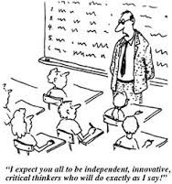

Slide 66
It is greater than God and more evil than the devil
The rich need it The poor have it If you eat it, you will die Who am I ?
nothing
Notes:
Go back to the beginning of the selection and focus only on the first line. Then move to the second line, third line, and final line. The information must be chunked to solve the riddle.

Slide 67
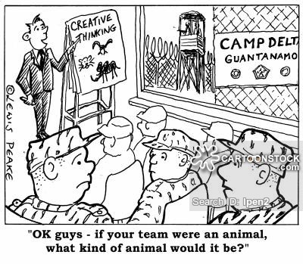

Slide 68
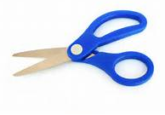
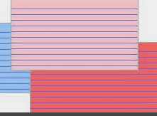
Person Through Card

Slide 69
Instruction to group: You have five minutes to devise a way of cutting the index card so that it creates a ring - without any breaks or joins - large enough to fit over both people, and then to step through the ring (in your pair/three/as a group).

Slide 70
Instruction to group: You have five minutes to devise a way of cutting the sheet of paper so that it creates a ring - without any breaks or joins - large enough to fit over both people, and then to step through the ring (in your pair/three/as a group).

Slide 71
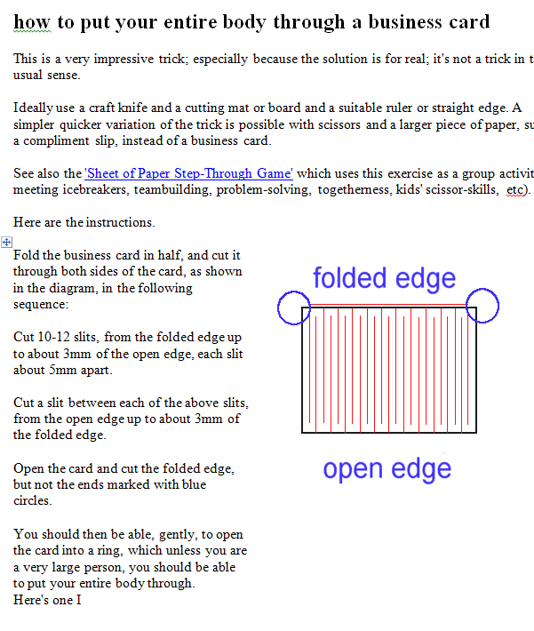

Slide 73
Biology and zoology are considered by many to be rich sources of analogies from which significant inventions can be derived. One of the most celebrated cases is the invention of the telephone. As Alexander Graham Bell wrote: "It struck me that the bones of the human ear were very massive as compared with the delicate thin membrane that operated them; and the thought occurred to me that if a membrane so delicate could move bones so relatively massive, why should not a thicker and stouter piece of membrane move a piece of steel." Thus was the telephone conceived.

Slide 74
Here is a list of animals and the inventions they exemplify. Try matching the animal with the invention.
1. | bat | ( ) | parachute
2. | armadillo | ( ) | snowshoes
3. | chameleon | ( ) | anesthetic
4. | fish | ( ) | helicopter
5. | flying squirrel | ( ) | suction cup
6. | squid | ( ) | hypodermic
7. | hummingbird | ( ) | radar
8. | scorpion | ( ) | camouflage
9. | snake | ( ) | electricity
10. | abalone | ( ) | tank
11. | caribou | ( ) | jet propulsion

Slide 75
Answers:
1. | bat | (5 | parachute
2. | armadillo | 11 | snowshoes
3. | chameleon | 9) | anesthetic
4. | fish | 7) | helicopter
5. | flying squirrel | 10 | suction cup
6. | squid | 8 | hypodermic
7. | hummingbird | 1 | radar
8. | scorpion | 3 | camouflage
9. | snake | 4 | electricity
10. | abalone | 2 | tank
11. | caribou | 6 | jet propulsion

Slide 76
How well do you know this situation? You've just been presented with a problem. You need to come up with an idea - fast. You come up with the big NOTHING! Later, while contemplating the shower head, BAM! The idea hits you out of the blue. A moment of inspiration... Can you guess the moment of inspiration for the fellow creators? Use your intuition.
1) | John Dunlop got the idea for rubber tires from... His garden hose A raincoat A molted snake skin A sugar maple tree
2) | Eli Whitney realized his concept for the cotton gin when he saw... A waterwheel A cat reaching through a fence trying to grab a chicken His landlord scraping a frying pan with a thin metal spatula A horse drawn sleigh
3) | Rudolf Diesel got the idea for the design of his diesel engine from looking at... A magnifying glass A typewriter A daVinci drawing of the human lung An Aztec spear

Slide 77
How well do you know this situation? You've just been presented with a problem. You need to come up with an idea - fast. You come up with the big NOTHING! Later, while contemplating the shower head, BAM! The idea hits you out of the blue. A moment of inspiration... Can you guess the moment of inspiration for the fellow creators? Use your intuition.
1) | John Dunlop got the idea for rubber tires from... His garden hose A raincoat A molted snake skin A sugar maple tree
2) | Eli Whitney realized his concept for the cotton gin when he saw... A waterwheel A cat reaching through a fence trying to grab a chicken His landlord scraping a frying pan with a thin metal spatula A horse drawn sleigh
3) | Rudolf Diesel got the idea for the design of his diesel engine from looking at... A magnifying glass A typewriter A daVinci drawing of the human lung An Aztec spear

Slide 78
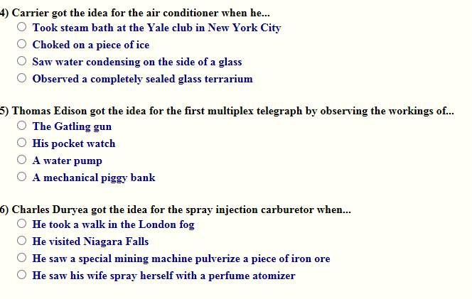

Slide 82
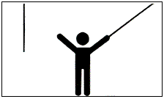
Look at the first sketch and imagine that you are the person shown standing in the room. You have been given the task of tying together the ends of the two strings suspended from the ceiling. The strings are located so that you cannot reach one string with your outstretched hand while holding the second in your other hand. The room is totally bare, and you have only the resources you would normally have in your pocket or handbag. How do you solve this problem?

Slide 84
Most people will see the difficulty as a shortness of reach. That is, they state the problem to themselves as: "How can I get to the second string?" The consequence of this perspective is that all effort goes into vain efforts to find a means of making one of the strings longer. But the "givens" of this problem make such a solution impossible.

Slide 85
If, however, you define the problem as "How can the string and I get together?", another sort of solution may occur to you. The solution requires that you see the difficulty in terms of getting the second string to come to you. If you tie a small object-say, a key or a ring-to the end of one string and set it swinging like a pendulum, you can grab it while still holding the end of the second string in the other hand.

Slide 86
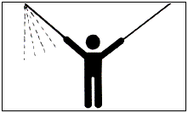

Slide 87
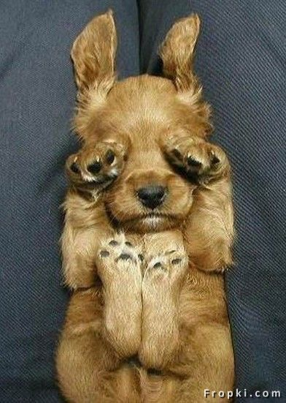
That’s all!

Slide 88
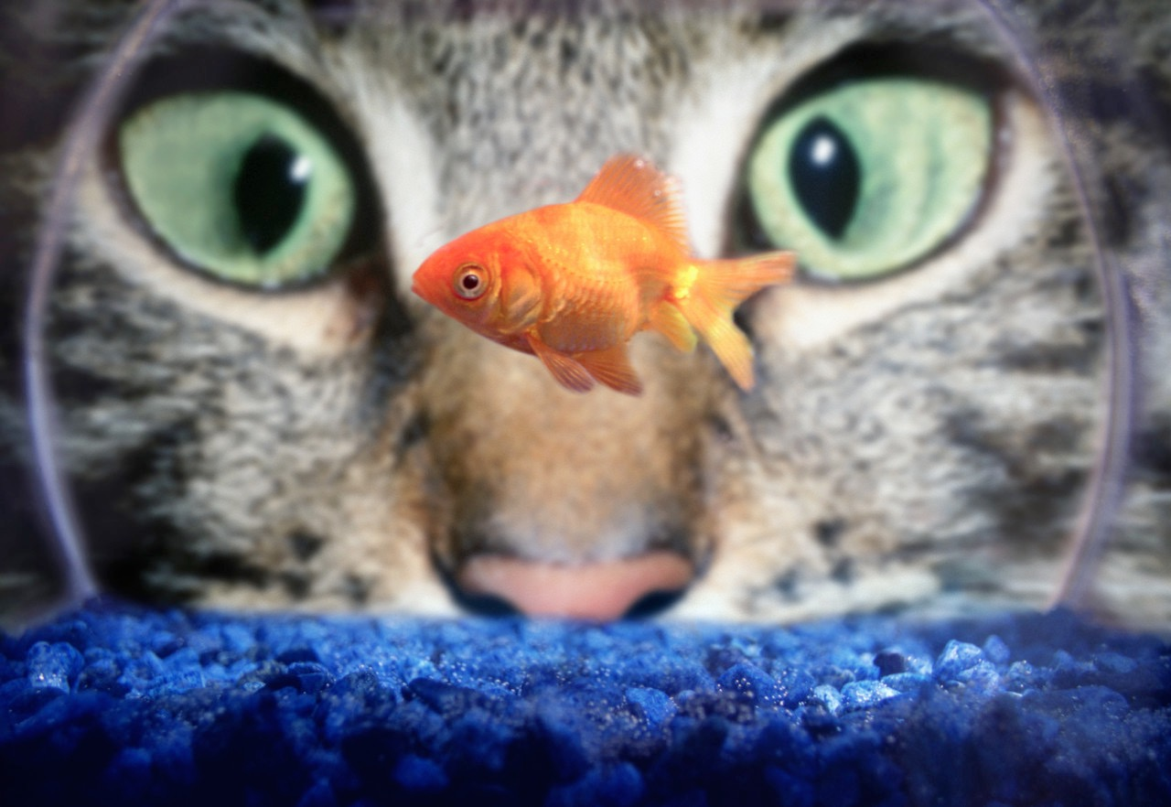
That’s All.

